Slide 1
Computer Network Lab
Lab-4

Slide 2
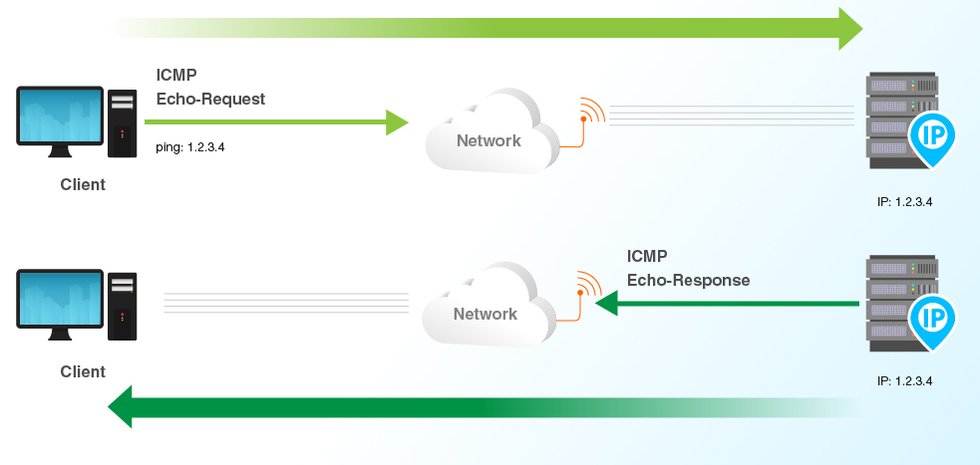
Ping
Options
c - limit the number of ping packets
i - change the time interval
l - without waiting for reply
s - packet size
n - hostname to ip address
p - fill pattern for data
Use “man ping” command to know more about options
To find the location of the server: https://ipinfo.io/

Slide 3
Latency
What is latency?
Friday:
--- flipkart.com ping statistics ---
1000 packets transmitted, 960 received, 4% packet loss, time 1906ms
rtt min/avg/max/mdev = 24.010/30.947/542.531/48.384 ms
Monday:
--- flipkart.com ping statistics ---
1000 packets transmitted, 999 received, 0.1% packet loss, time 1434ms
rtt min/avg/max/mdev = 70.779/73.978/75.280/1.638 ms

Slide 4
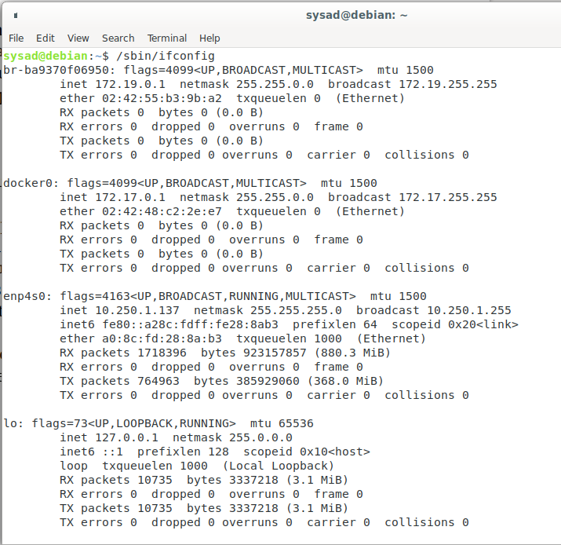
Ifconfig
Stands for interface configurator
View and change the configuration of network interface
/sbin/ifconfig
Options
a - all the interfaces
v - verbose mode - log all details about execution
man ifconfig for more details
Flag
up=0x1, running=0x40, broadcast=0x2, multicast=0x1000
Hexa 1043 -> 4163

Slide 5
traceroute
Prints the route that a packet to reach the host
Friday 5th-Feb-2021 | Monday - 8-Feb-2021
traceroute to www.facebook.com (157.240.23.35), 30 hops max, 60 byte packets 1 _gateway (10.250.1.250) 0.277 ms 0.316 ms 0.391 ms 2 firewall.iitdh.ac.in (10.250.209.251) 0.126 ms 0.098 ms 0.064 ms 3 61.0.239.225 (61.0.239.225) 1.444 ms 1.387 ms 1.659 ms 4 117.216.207.218 (117.216.207.218) 15.149 ms 15.187 ms 15.160 ms 5 * * * 6 * * * 7 * * * 8 * * * 9 * * * 10 117.216.207.122 (117.216.207.122) 23.547 ms 24.121 ms 24.052 ms 11 ae20.pr01.maa2.tfbnw.net (157.240.68.20) 25.258 ms 25.922 ms 25.081 ms 12 po131.asw03.maa2.tfbnw.net (157.240.54.46) 23.837 ms po131.asw02.maa2.tfbnw.net (157.240.54.42) 24.403 ms po131.asw03.maa2.tfbnw.net (157.240.54.46) 24.441 ms 13 po223.psw03.maa2.tfbnw.net (157.240.54.131) 25.991 ms po225.psw03.maa2.tfbnw.net (157.240.54.135) 26.004 ms po226.psw03.maa2.tfbnw.net (157.240.54.137) 25.982 ms 14 173.252.67.183 (173.252.67.183) 25.466 ms 173.252.67.87 (173.252.67.87) 25.466 ms 173.252.67.81 (173.252.67.81) 24.477 ms 15 edge-star-mini-shv-01-maa2.facebook.com (157.240.23.35) 23.827 ms 24.542 ms 24.421 ms | traceroute to www.facebook.com (157.240.16.35), 30 hops max, 60 byte packets 1 _gateway (10.250.1.250) 0.244 ms 0.306 ms 0.406 ms 2 firewall.iitdh.ac.in (10.250.209.251) 0.078 ms 0.082 ms 0.058 ms 3 14.139.150.65 (14.139.150.65) 0.419 ms 0.421 ms 0.564 ms 4 * * * 5 * * * 6 * * * 7 10.152.7.38 (10.152.7.38) 67.888 ms 68.263 ms 68.275 ms 8 ae1.pr01.bom1.tfbnw.net (157.240.68.238) 66.368 ms ae2.pr02.bom1.tfbnw.net (157.240.66.204) 67.262 ms ae1.pr01.bom1.tfbnw.net (157.240.68.238) 66.338 ms 9 po101.psw02.bom1.tfbnw.net (157.240.33.239) 64.338 ms po101.psw03.bom1.tfbnw.net (157.240.40.229) 64.089 ms po102.psw04.bom1.tfbnw.net (157.240.45.49) 64.184 ms 10 173.252.67.27 (173.252.67.27) 66.163 ms 157.240.38.225 (157.240.38.225) 66.831 ms 157.240.38.191 (157.240.38.191) 66.807 ms 11 edge-star-mini-shv-01-bom1.facebook.com (157.240.16.35) 64.867 ms 64.668 ms 64.855 ms

Slide 6
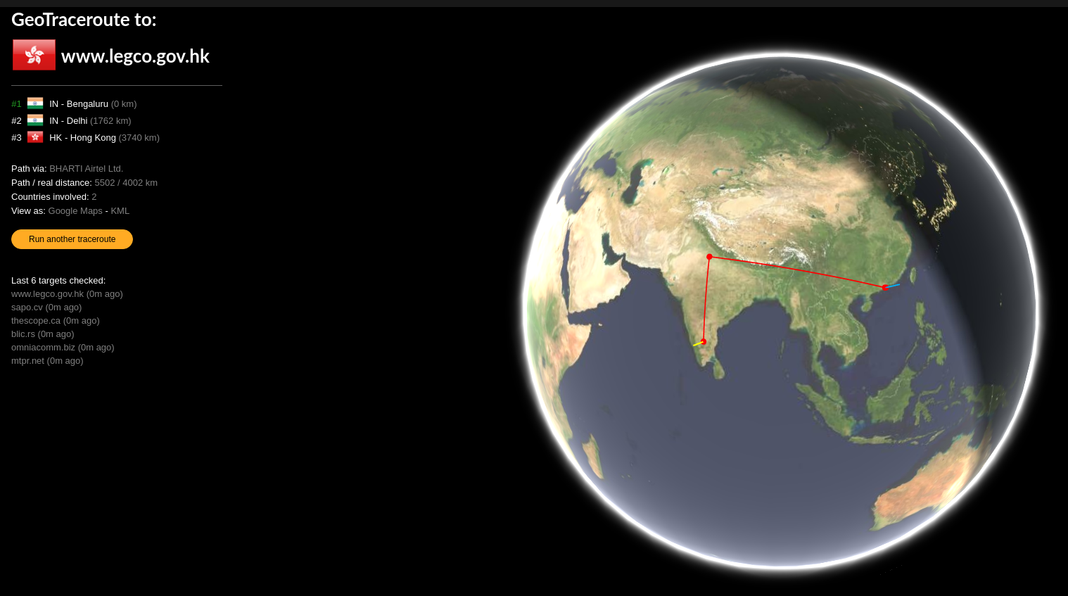
Link: https://geotraceroute.com/

Slide 7
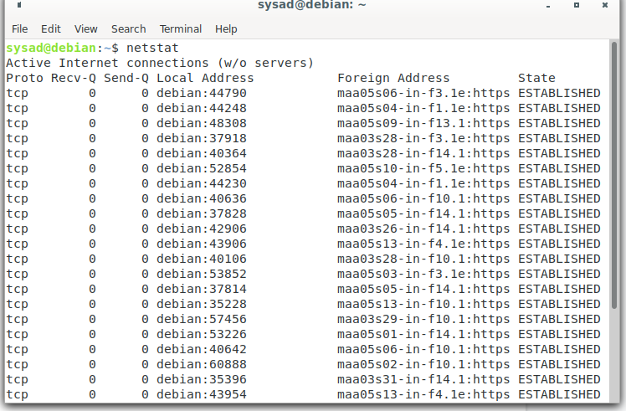
netstat
Network related information
Options:
t - display all the TCP connections
u - display all the UDP connections
r - display routing table
i - display the table of network interface
$man netstat

Slide 8
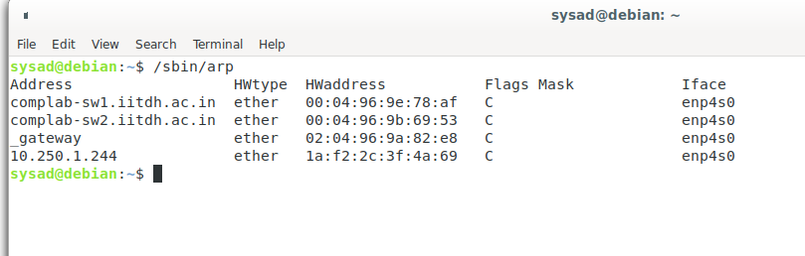
ARP - Address Resolution Protocol
Add, delete, display or manipulate the arp table content
Options
a - alternate BSD style output format (with no fixed columns)
v - shows verbose information
s - to manually set MAC address of an IP
d - to delete an entry

Slide 9
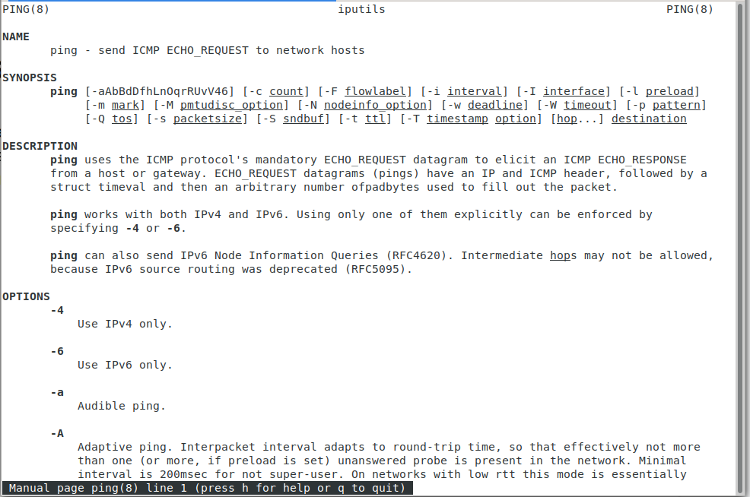
man (manual) page
Kindly refer the man page for all the commands like ping, traceroute, arpt, netstat, etc.
Please refer to the corresponding UNIX man pages for better understanding as this will help you to solve the questions asked in Assignment - 4.
Syntax:
$man <CommandName>
Ex: $man ping

Slide 10
Thanks you

